Slide 1
Cisco Rapid Iteration for NetOps and Devops Engineers
Updated January 2022
RAD SDLC Lab
Sherri Conrod
Solutions Architect, Global Partner Organization
February 2022

Slide 2
Way of Working
RAD SDLC Work-Flow Model for Lab
Each Participant will be actively working in the lab from the start, which means they will be typing on their keyboard to edit code, push their code to a repo, and watch their code build in the pipeline as well as logging onto FSO Consoles to view the results of their automation
Each Participant will:
be assigned a Region by the Instructor and a git branch. The Instructor will add each participant to the git org, and the Participant will receive an email invitation they will accept
Start the Lab by cloning the lab repo and checking out their assigned Branch/Region
Students must already have a 4096 bit RSA Key associated with their github account
Clone the lap repo and checkout their branch. Update their vars file after receiving instructions then do a git add, commit, and push to their branch –this will ready their CI Pipeline to deploy their cloud lab environment
The Participant will be provided a login to the CI Tool: http://ci.devops-ontap.com:8080
The Participant will logon to the CI Tool and select to deploy their lab environment to the Cloud
Once deployed, the Participant will set up the SSH keys generated during the lab setup to verify they can SSH to their cloud instances

Slide 3



Devops Workflow
Sprint Meeting:
Based on capacity and priorities, stories are assigned to Team Members.
Stories can be additionally broken up and estimated. Stories are assigned to Individual Team Members
Engineer creates a new branch from the DEV branch, and names it with the Jira Story Number / Engineer’s Name. Example:
1234567/jsmith.
An Engineer can have as many branches as they like depending on how many stories/features/etc.
Engineer beings using rapid iteration to develop code
Engineer tests their code in tasks (the tasks pull the curated OCI images to build the code)
When tasks passes, Engineer will merge into branch from upstream branch to ensure they have all recent merges and re-test. If green:
Engineer builds their branch in the pipeline
If the pipeline builds successfully, Engineer creates a PR.
Team Lead(s) will verify code branch has passed and will review changes in git and either reject or pass and merge.

Slide 4
Infrastructure Release Workflow
Sprint Deadline: All Engineers will create PRs for their work which has passed a successful build in their branch & the dev pipeline
The Leads will decide what gets included (merged)
After all work is merged, the Leads will build DEV branch
If the DEV pipeline builds Ok, it automatically “kicks” off the upstream application DEV Team’s pipelines. Ie) Shopping Cart Java Web App etc. These upstream pipelines will build from the other teams current release code. So you are verifying that all the upstream app code version that are currently work in prod, will work on your new DEV infrastructure code.
If all upstream Team’s pipelines build green on top of the infra DEV branch pipeline, the infra DEV gets promoted to QA. In QA extensive regression testing occurs.
Once QA is green, the Lead(s) cut a Symantec release of what is now the new Prod version of the Infra Pipeline and it is blue-greened(where possible) into Prod

Slide 5
PROD OCI = DEV OCI
PRODUCTION DOWN! Teams that perform local development are more likely at risk of having a successful test cycle in the lower environments and still break in prod
WHY?
No two developer local machines are the same in respect to: libraries, modules, configuration, env vars, params, os versions etc. Thus building code locally and testing is not valid or reliable.
ALL CODE MUST BE BUILT ON THE SAME OCI IMAGES BY ALL DEVS THROUGHOUT THE ENTIRE DEV CYCLE!!!!!!! THIS IS THE ONLY WAY TO ENSURE 100% WHAT PASSES IN THE LOWER ENVS WILL PASS IN PROD!

Slide 6
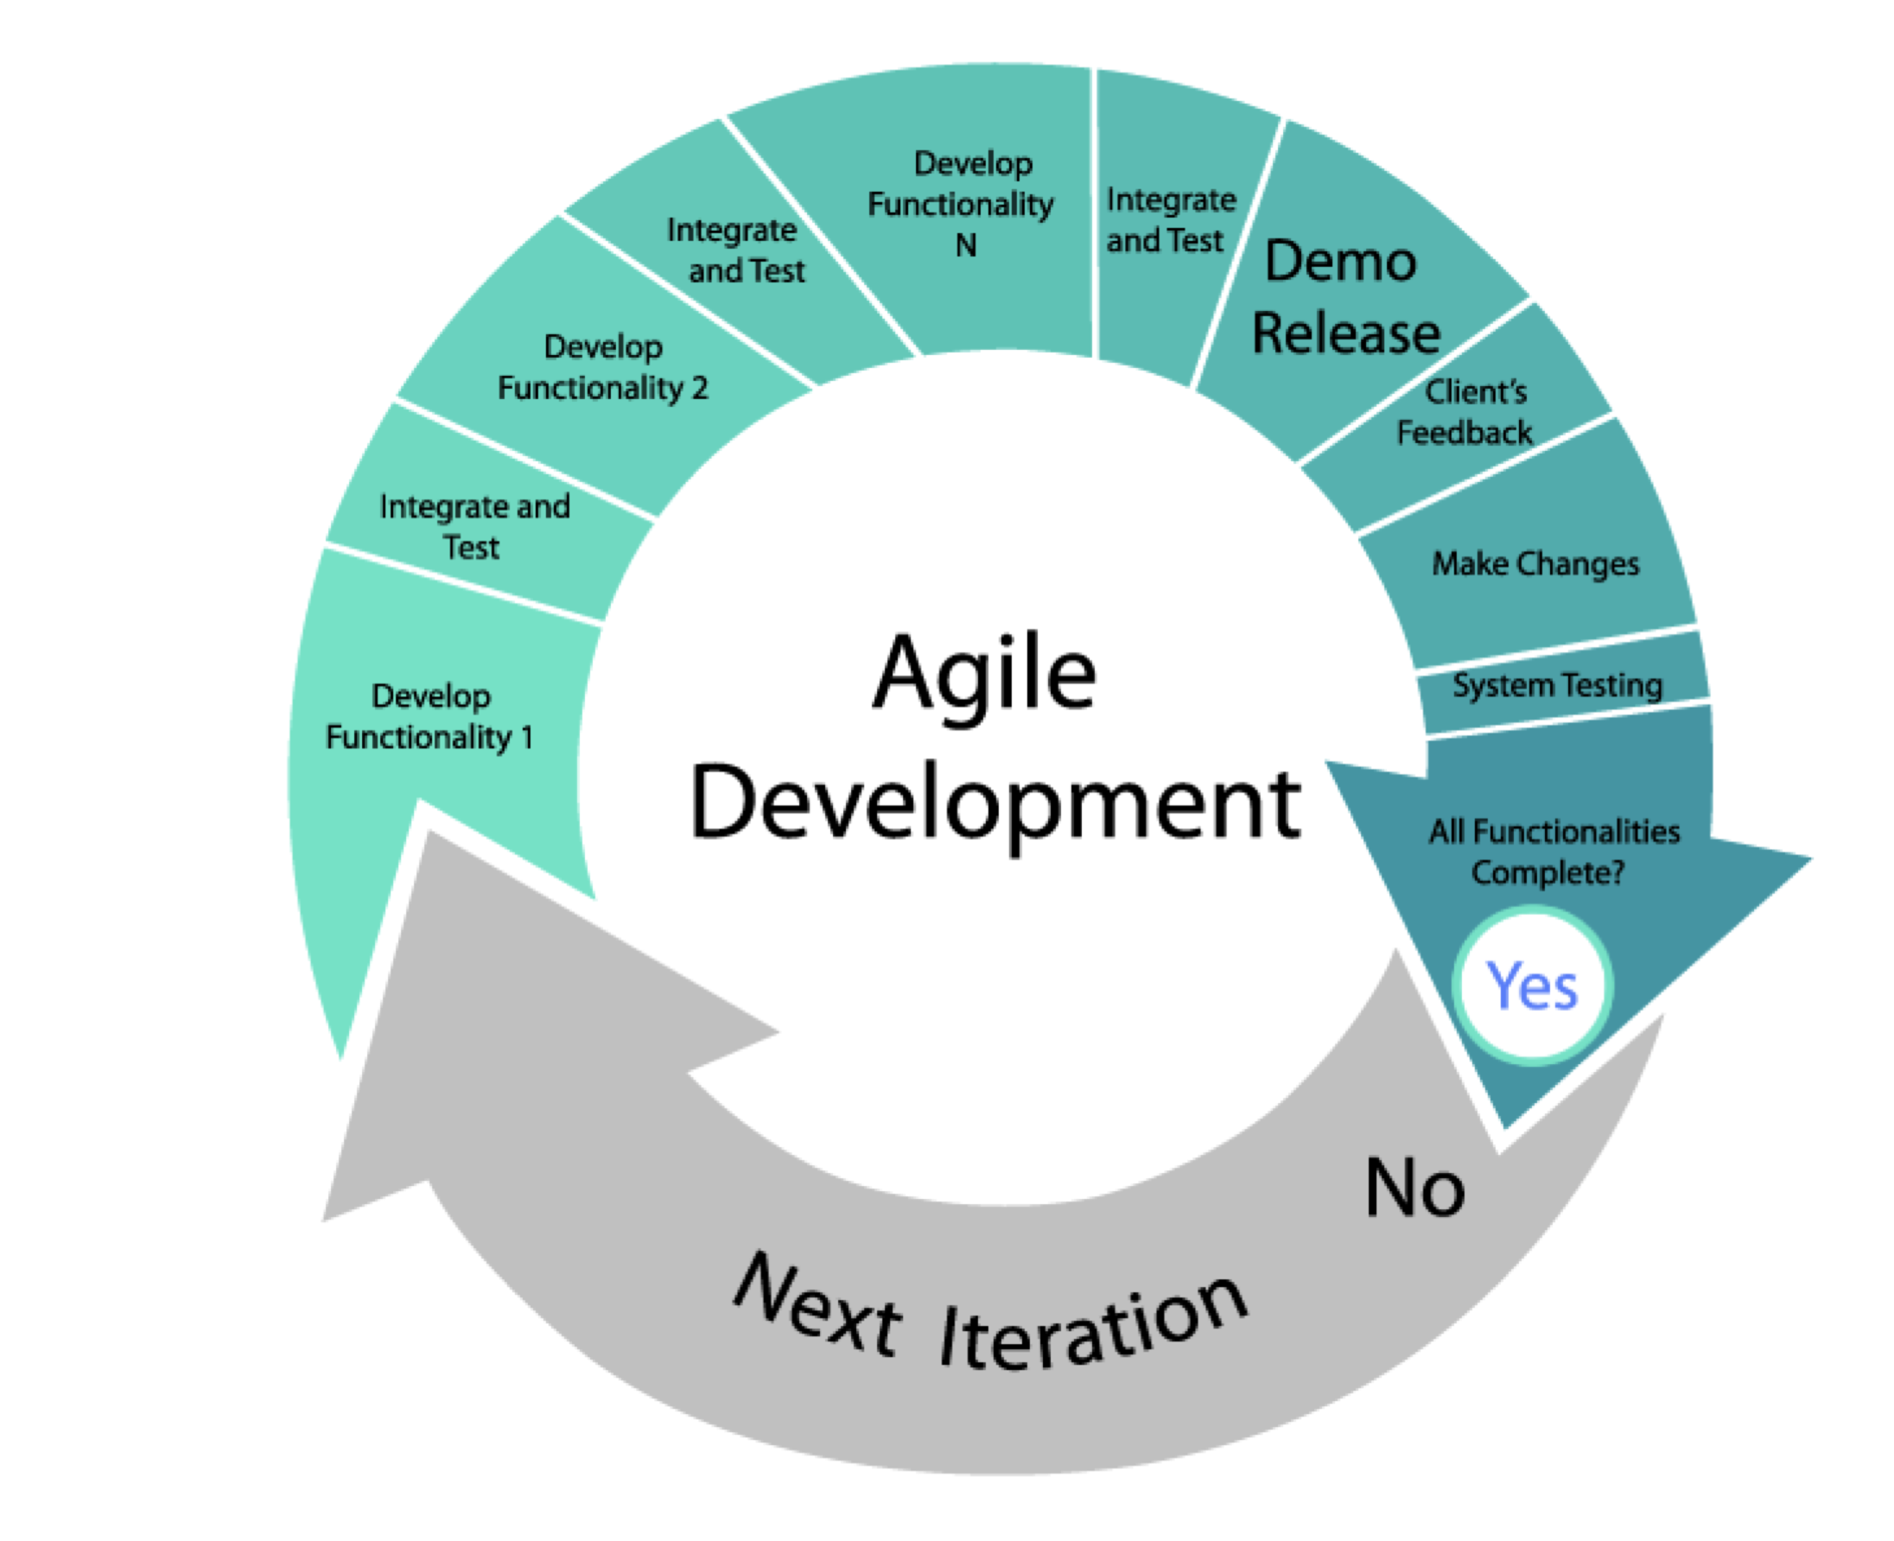




RAD SDLC Workflow
Fill this with a relevant photo, illustration, graph, etc.
Git – All Changes in Git
Pipeline Builds Env and Config from Git Branch
Pipeline Builds Environment and Configurtions via Git using Docker based Build Containers
Pipeline Build Containers do the work of Communicating with Vault, AWS, Docker, Git to deploy the Env to AWS from Code
Students update git only to kick off pipeline to make config changes to lab environment

Slide 7
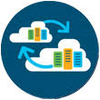
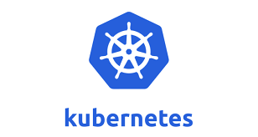

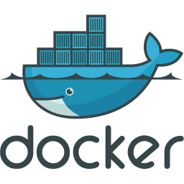



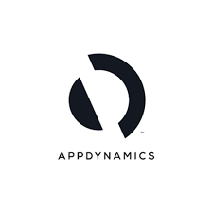


RAD SDLC Work Flow
Netops/Devops
GUI Users (Application Users)

Slide 8
Each Lab User is Allocated:
1 VPC
2 Subnets in the same AZ
Route Tables - One Route Table Associated to LAN RT Subnet
with 0.0.0.0/0 ->IG Associated to the 10.10.10.0/0 Subnet
Internet Gateway: IG
Security Group with Inbound/Outbound Rules - Since we are not using a VPN between Lab users and Lab, we will allow inbound on 22
1 CISCO CSR1000V Cloud Services Router - We will route traffic to Internet via the secondary interface
2 Linux 20 LTS Pro t2.micro
1 Pipeline, 1 Kubernetes Name Space, X number of Apps
Console Access to FSO Stack: Thousand Eyes, App D, Intersight

Slide 9
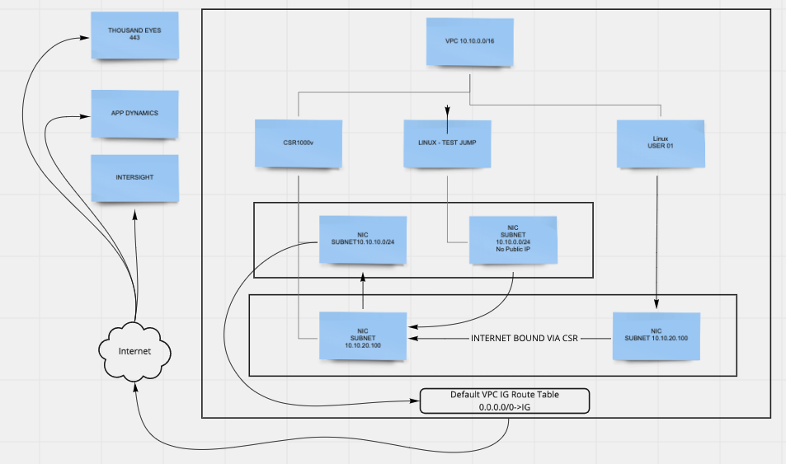
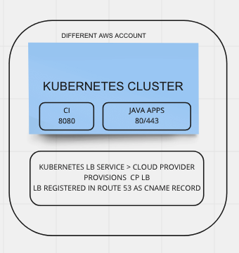
CISCO FSO ESCAPE ROOM LAB

Slide 10

Lab Environment
Lab Phase 1: Theme: Cloud Disaster Recovery Escape Room.
Lab Overview: Today we are simulating being members of the same Netops/Devops Team in a Large Software Environment. When you come into work, you discover that Your AWS Regions for Production are experiencing an extended outage. Your IT Director instructs you to deploy your environment to other Regions immediately. He delegates each of you a Remote/Office/Site/ Branch to Re-Deploy.
You have only 20 minutes to get your Company backup and Running! The Company is losing $50,000 every minute of downtime. If you can get your company back up and running in less that 20 minutes you get a bonus. You say “no sweat, all our infra is managed as code..
hold my beer……..”
After you restore the environment, you convince your Boss to Deploy
Cisco Thousand Eyes to help mitigate a Disaster like this in the future.
Deploy Environment – Team Competition – Fastest Time 12 minutes!
Deploy Thousand Eyes Agents – 30 min
Logon to TE Console – Console Overview 30 min
Configure TE Tests – Console and API 30 min – 1 HR.
The Winners Gets a Prize!!!!!!!!

Slide 11
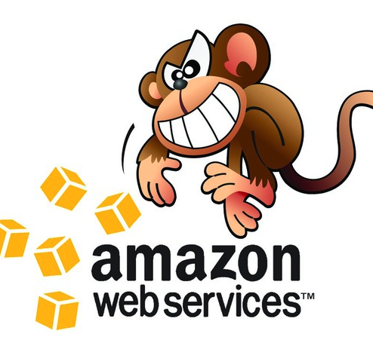
Warning! The Chaos Monkey May Strike Overnight at Anytime! Please ensure you Commit your code the end of day!

Slide 12
Lab Instruction: Phase 1 Part 1 (20-30 min) Clone Repo Checkout Branch & Fetch Updates Verify your lab_vars.py file, update your lab-note.txt Git Add, Git Commit, Git Push Logon to Pipeline Deploy Pipeline – Capture your SSH Key SSH To Test Linux, CSR Wait for Instructor Before Configuring CSR Lab Instruction Phase 1 Part 2 (10-20 min) CSR – check 2nd NIC Run the Configure CSR Task to Configure your CSR Verify that traffic from Linux User01 is being routed outside CSR Deploy Thousand Eyes Agent on Linux VMs Logon to Thousand Eyes Console Students Commit Code to Branch for Overnight Marking. Code Passing Tests will be added to Student Pipeline. At End of Training Lab on Final Day, Students will be challenged to rebuild their lab 100% from their Code Branch.

Slide 13
10 min Bio Brake
Instructor will share screen and demonstrate hands on activity (10 min)
Lab Users will Have 20 minutes to Complete Phase 1 of Lab
Ready….Set…..Go!!!!!!!
Good Luck!!!!!!!

Slide 14
Thousand Eyes – Phase 2 Lab Instruction: Phase 2 Part 1 (20-30 min) Instructor Led Demo of Thousand Eyes GUI Interface & Sample API Requests {NTERONE CURATED CONTENT ON THOUSAND EYES} Phase 2 Part 2 (30 min) Lab User Configures Tests using GUI and API App Dynamics – Phase 3 Lab Instruction: Phase 3 Part 1 (20-30 min) Instructor Led Demo of Installation of AppD Client(s), GUI Walkthrough, Sample API Requests {NETERONE CURATED CONTENT FOR APPD} Phase 3 Part 2 (30 min) Student Installs AppD Agents on Linux, Logs into their Console, Configures and Runs API Requests Students Commit Code to Branch for Overnight Marking. Code Passing Tests will be added to Student Pipeline. At End of Training Lab on Final Day, Students will be challenged to rebuild their lab 100% from their Code Branch.

Slide 15

Ways of Working Day 1 Summary Building IP
Knowledge Workers Share the Company Mindset of Developmental Operations
Example Following Agile Code Development Methods
The Technical Lead(s) will evaluate, and mark and story assigned to a KT worker for Automation and Code Re-useability.
Projects marked for “automation” or “code re-useability” will require the KT worker to perform daily commits on their work. Ideally the commit should update the Jira Story, but if this level of integration is not in place the KT worker should be updating the Jira Story at the end of each day with a link to their latest code commit or a summary of work completed.
Code will include all scripts and all work should be done in a generic method so that it is written with re-usability in mind. Example, no hard coding, all variables, all creds (authentication and authorization) handled via a vault etc.
The Tech Lead should be able to review Code from Time to Time and Report on Weekly the commits and ensure the quality of the code meets company standards. It is important to have a ”Code Standards” Document outlining your Coding Standards. This can initially be a simple document and can be developed over time.
Code should be demonstrated to at least one Pear on the Team in a live demo before being handed off to the Customer for QA.

Slide 16

Resource Alignment
The Technical Lead will identify the most suitable Knowledge Workers to work on the engagement and will provide to them well defined technical deliverables. The Best Knowledge Worker who is developing the code is probably not going to be the Resource who interfaces with the customer. Be careful to put the Resource with the “People Skills” in front of the Resource with the “Tech Skills.” The way to do this is by assigning a “Service Manager” role to interface regularly with the Customers to ensure that their feedback is captured and relayed back to the Technical Resources. It also shields Technical Resources from political and other pressures that could impact their ability to focus on the Technical Deliverables.
Example:
The Technical Lead for the Engagement has translated the business requirements into Technical Epics in Jira.
The Tech Lead meets weekly with the Team of KT workers for their vertical and verbally goes over and clarifies the Epics.
The team works to break down the EPICs into smaller stories. Each Team Member based on their work capacity will either be requested or will volunteer to take ownership of x number of stories.
Each Story should be linked to either a Code Repo or Branch of a Code Repo if there will be any Code Developed
The Link to the Repo, or the Work Repo should be updated into the Jira Story. ***In advanced environments, this code repo or branch will kick off a pipeline build****
This ensures that we can:
Iterate on the code
Hand off the code – ensure our own business continuity as well as the customers
Collaborate on the code
Re-use the code for future engagements

Slide 17
Tool Sets
It is important never to get “locked in” to a specific tool set. Tool sets change and evolve rapidly over time.
Getting ‘locked into’ a toolset can impede and negatively impact your future and ongoing ability to “flex” and implement newer better more efficient technologies rapidly.
It is important to design your tool-kit to be able to swap out any single tool rapidly without impact to your business.

Slide 18
Tool Set Plug and Play Architecture
Keep the Tool Set investment as lean and plug and play as possible
Implement your use of tools with the mindset that in 2 years, a better, superior tool will take its place that the adoption thereof will improve the speed, efficiency, profitability of your business while improving your product and delivery.
When the new tool comes along, you want to be able to ”adopt it” immediately
Example: Kubernetes

